Slide 1
Education Health and Military Expenditure Visualizations of Nations.
DATS 6401 – Individual Project – Ishank Kankaria

Slide 2
DataSets
The datasets were obtained from the following sources.
WorldBank
OECD (Organisation of Economic Co-operation and Development)
SPIRI
Contains 2010-2015 data (6 years)
Stored in Google Sheets API

Slide 3
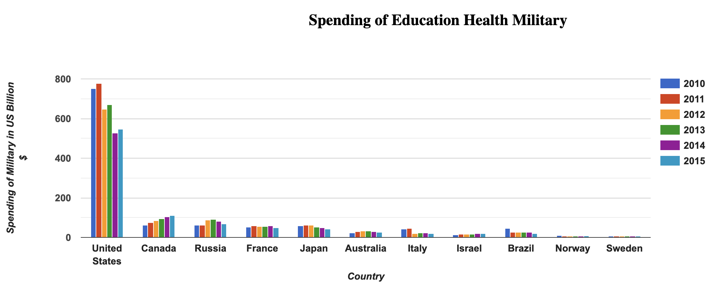

Slide 4
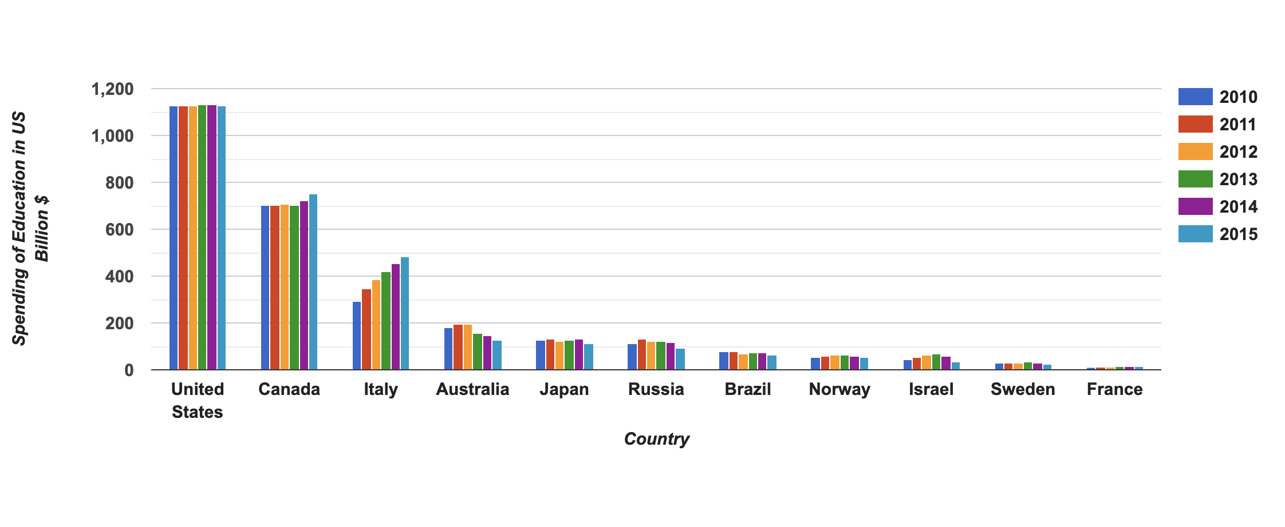

Slide 5
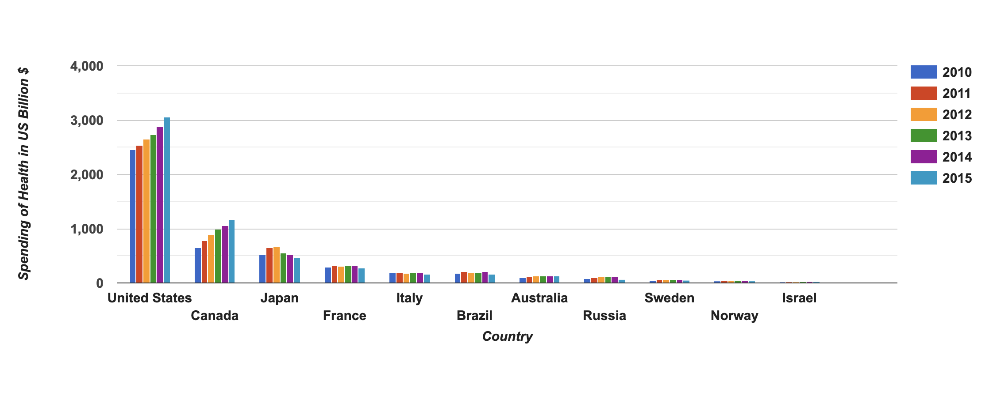

Slide 6
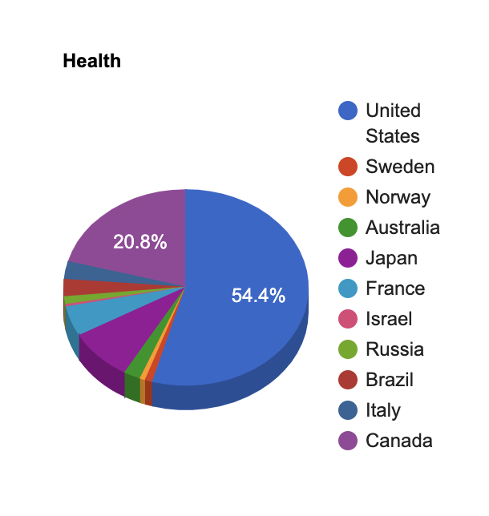
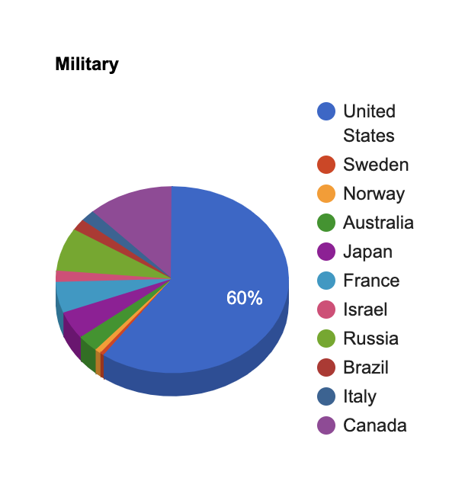
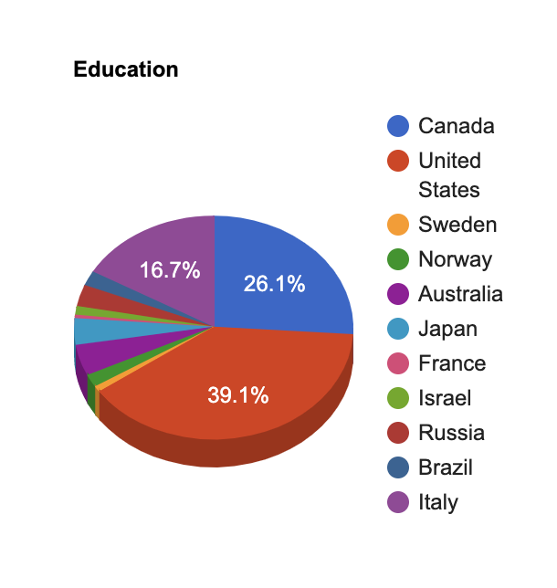
Sector Spending Pie Chart

Slide 7
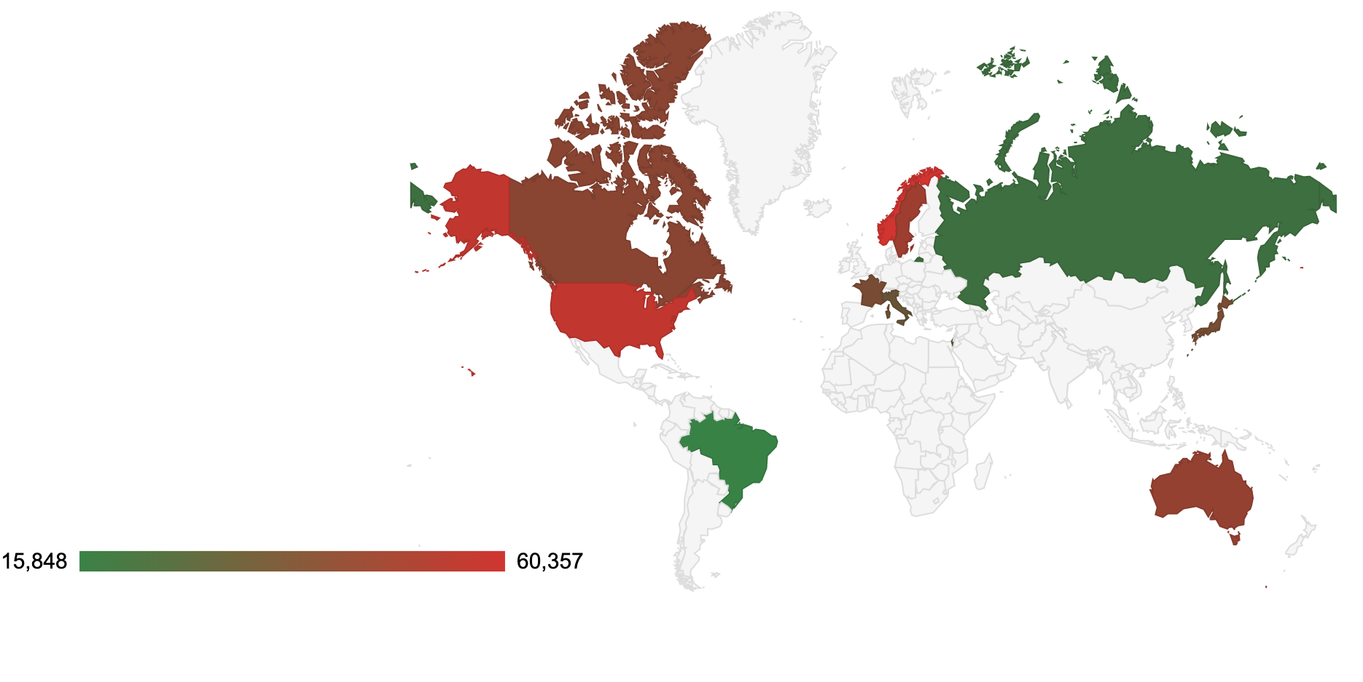
GDP PerPerson GeoChart

Slide 8
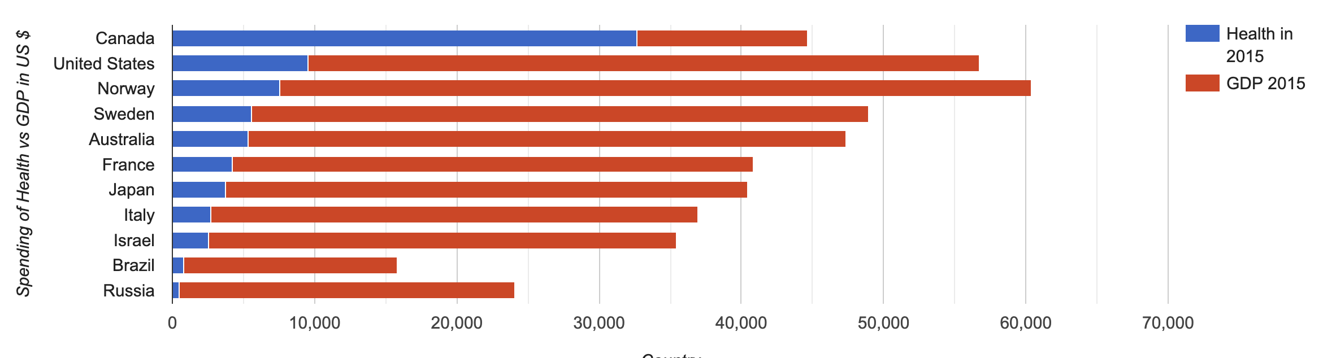
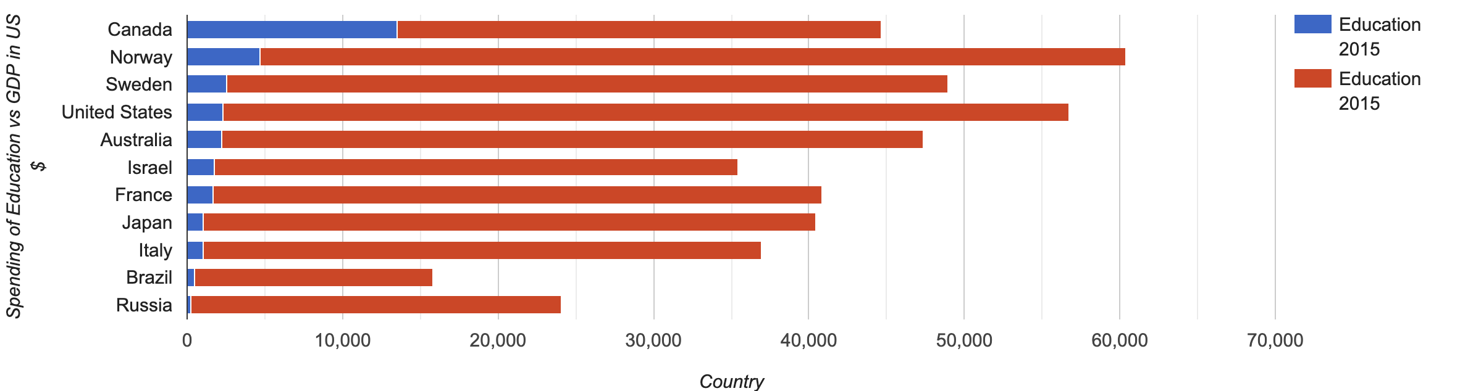
Health Education Military vs GDP

Slide 9
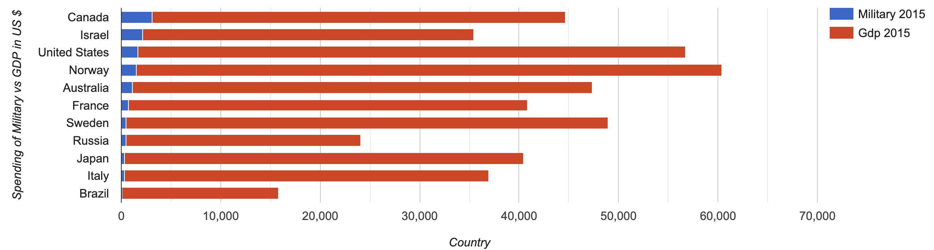

Slide 10
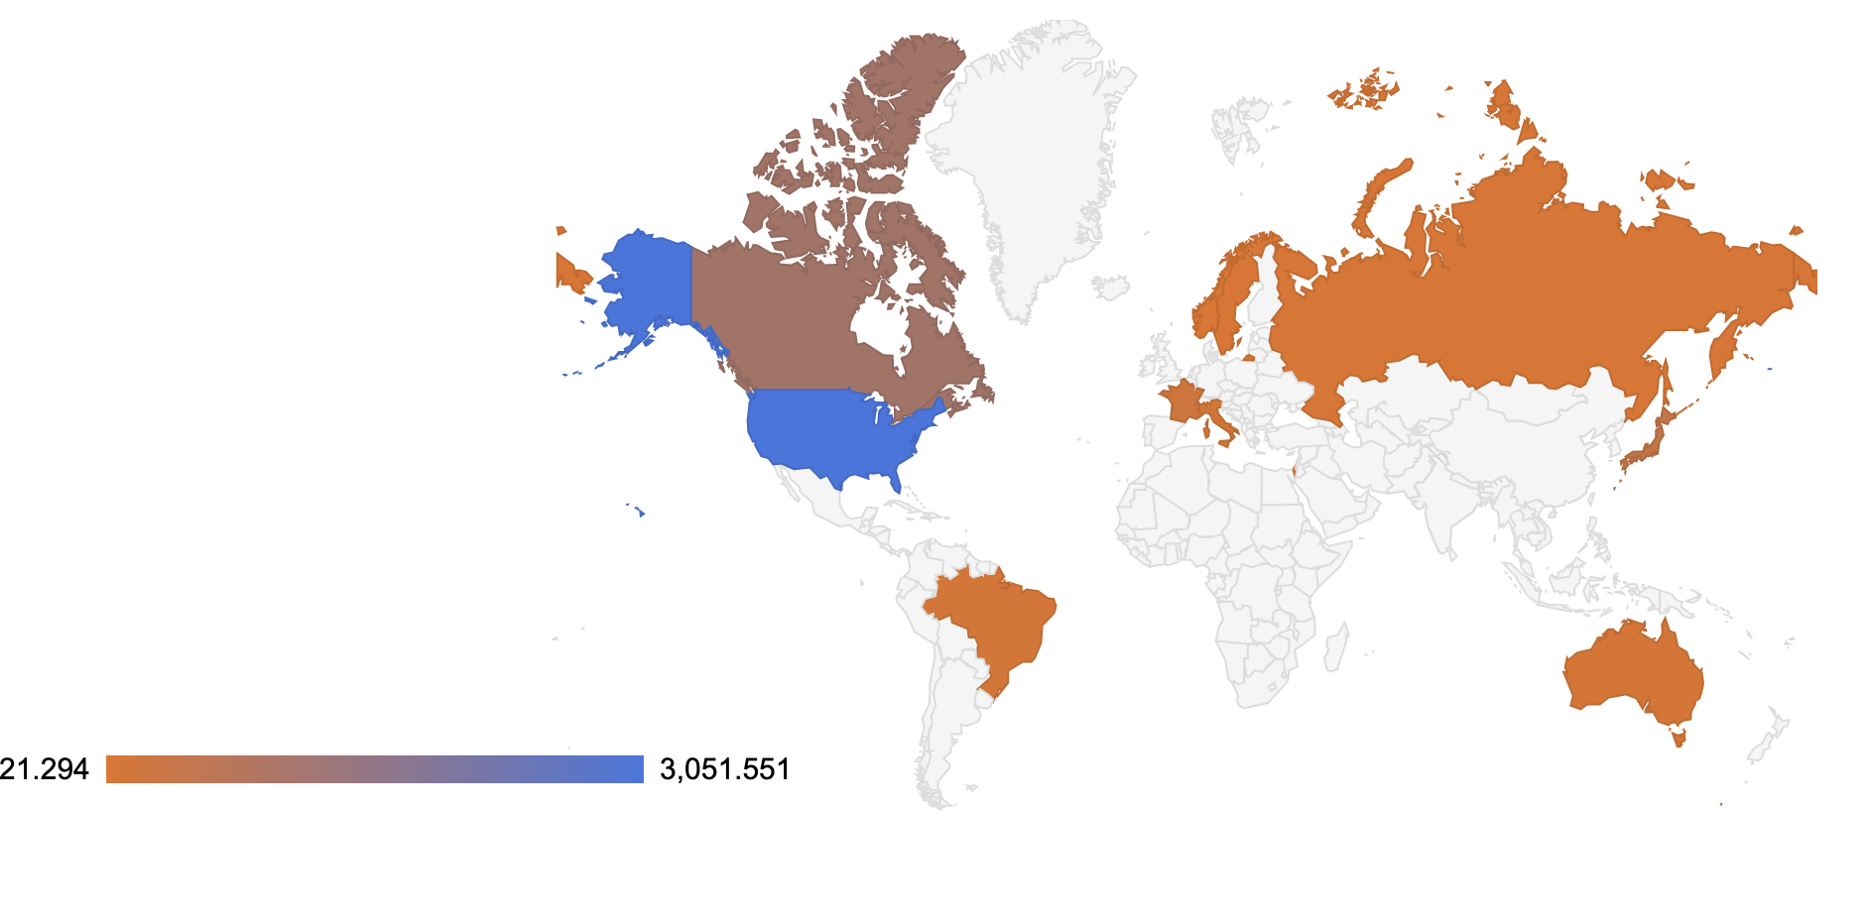
Military Spending

Slide 11
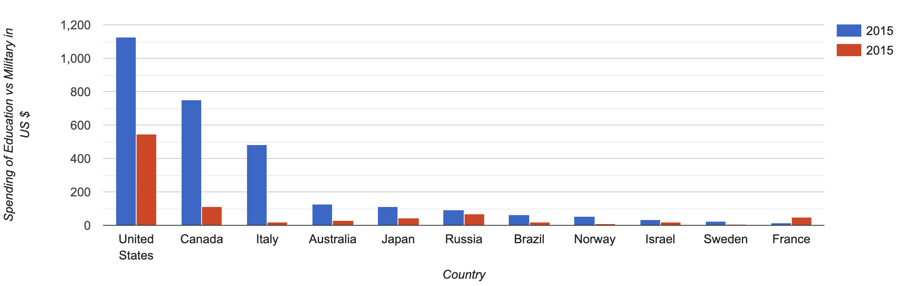
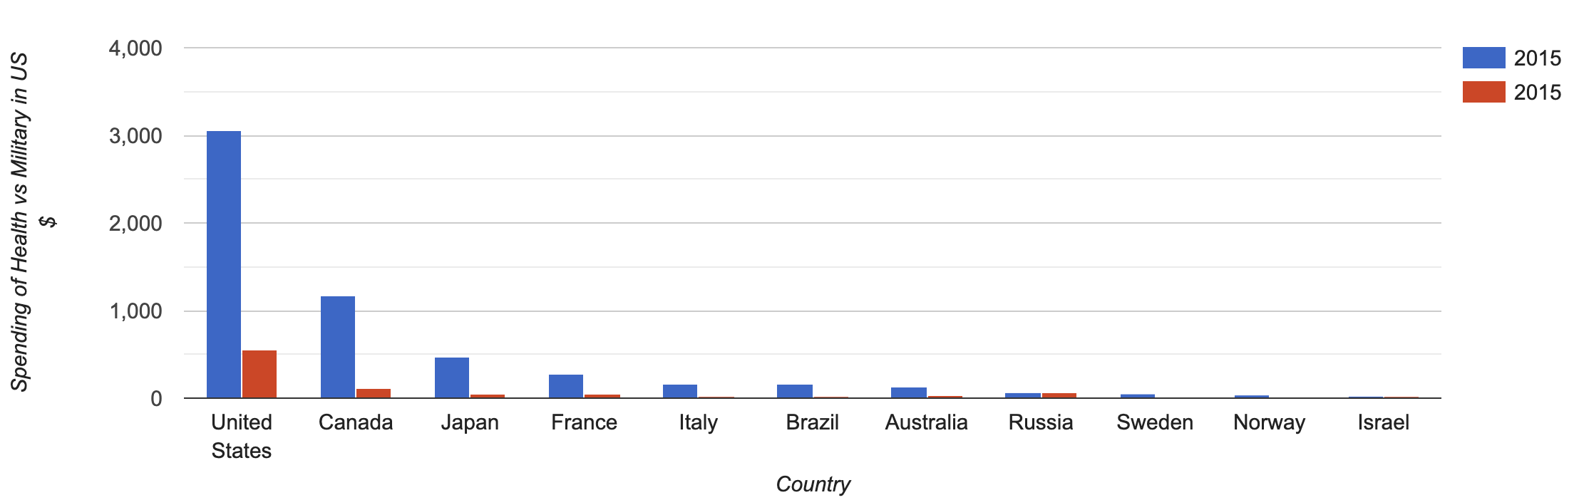
Military vs Education and Health

Slide 12
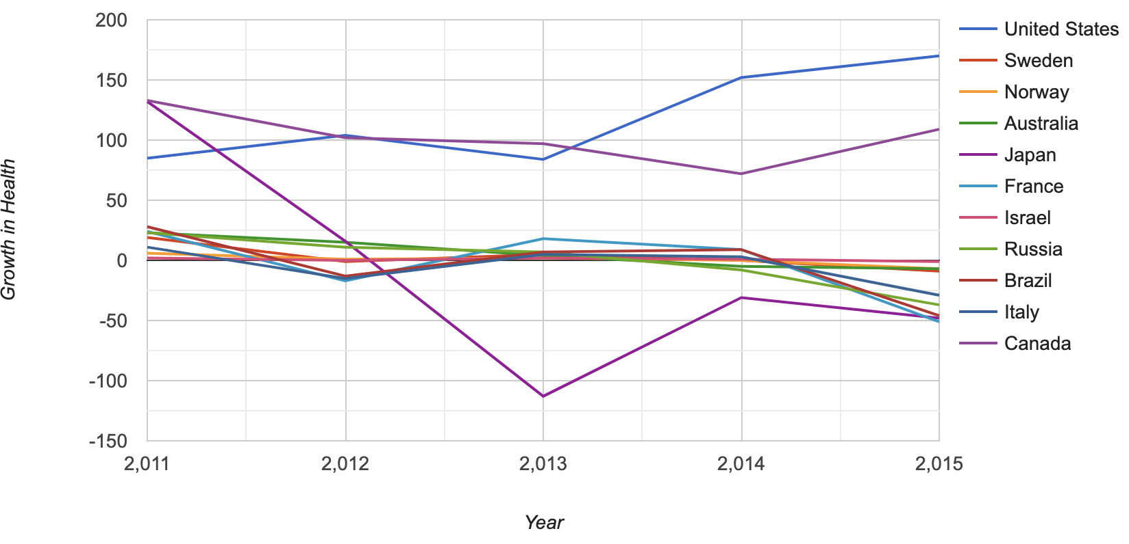
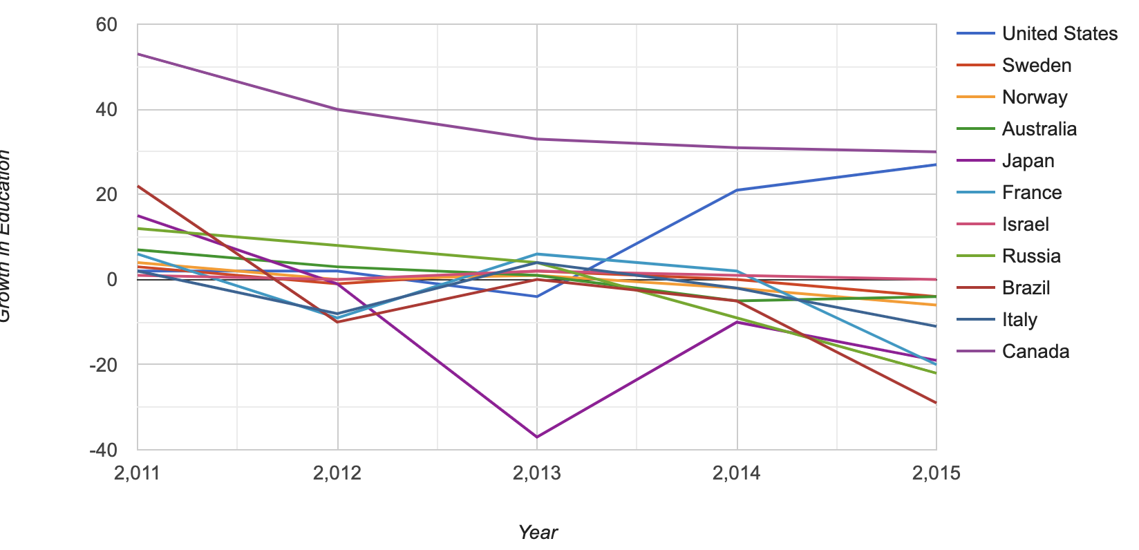
Growth Rate in Terms of Counts

Slide 13
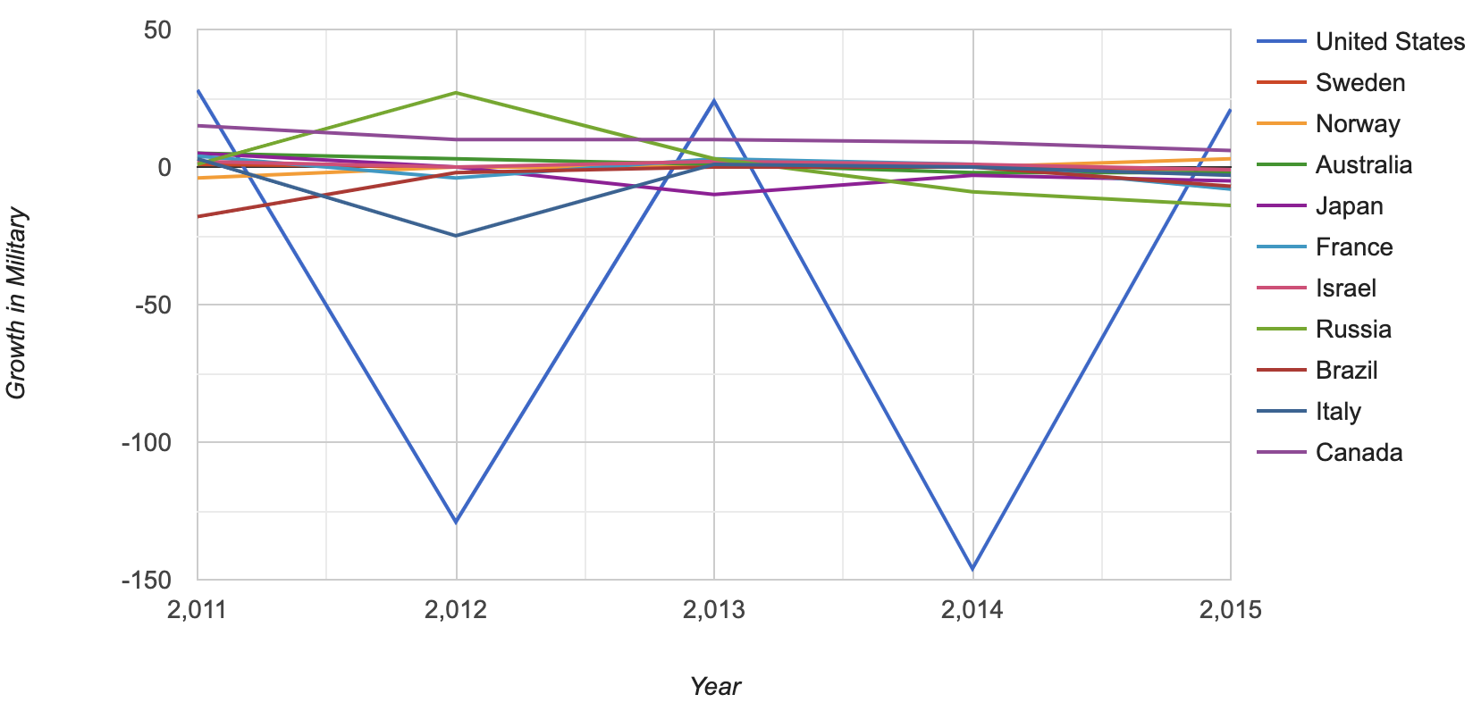

Slide 14
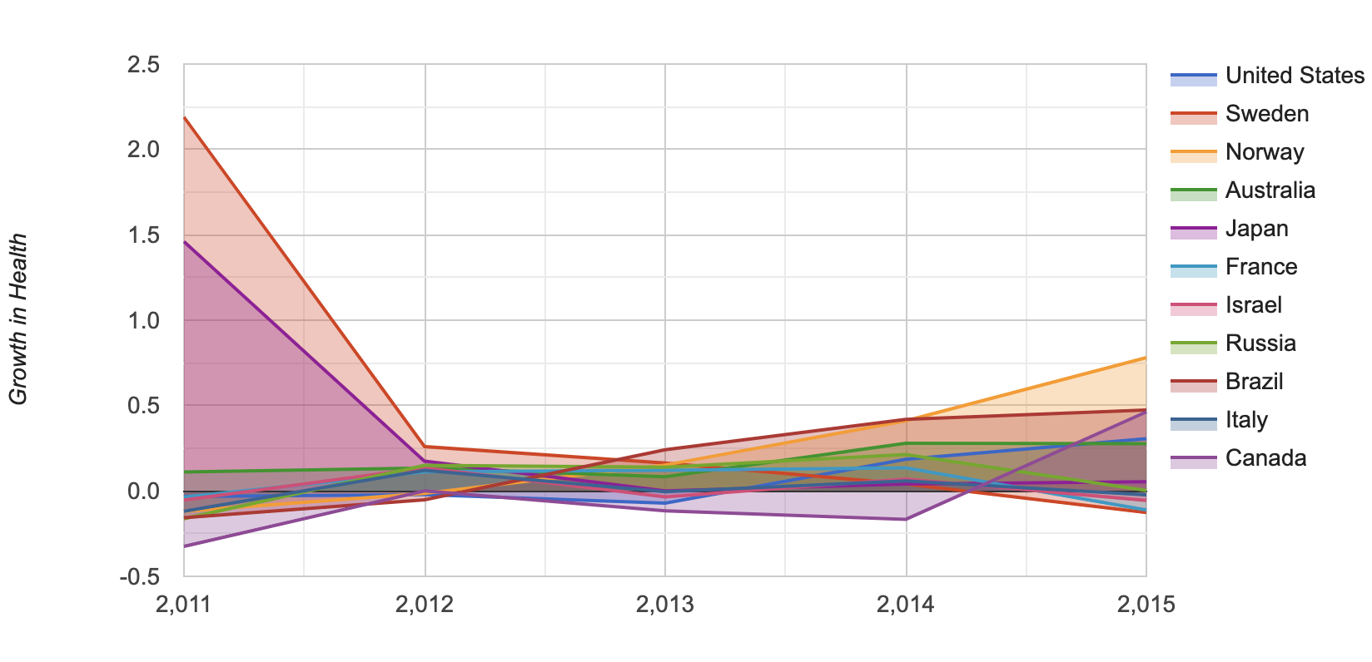
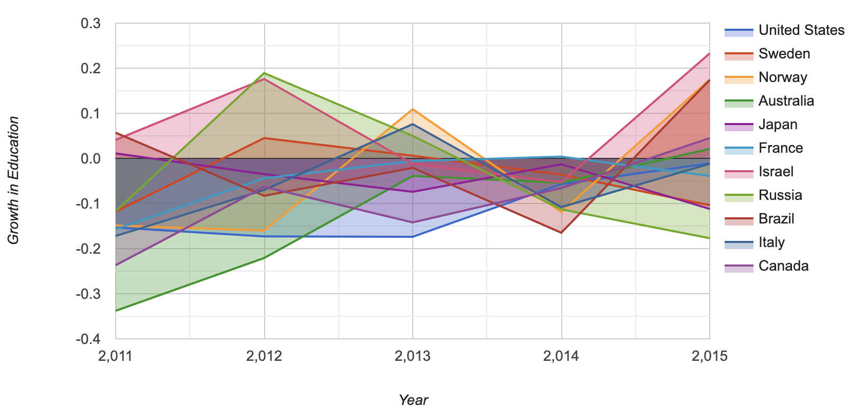
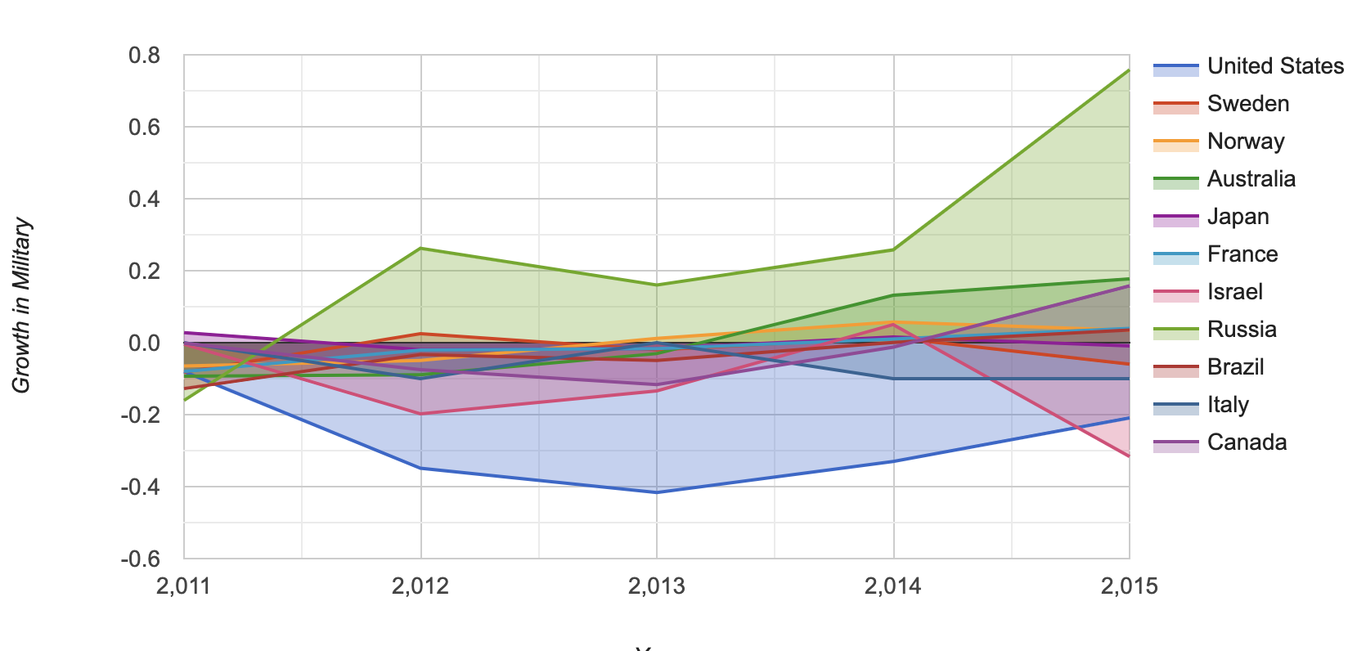
Growth Rate in Terms of Percentage

Slide 15
Conclusions
United States is by far the highest in spending for all the three sectors
Norway has Highest GDP per person
Canada is highest for Per-person spending in all of three sectors
Israel has the highest growth in Education
Canada and Australia have highest growth rate in military

